Slide 1
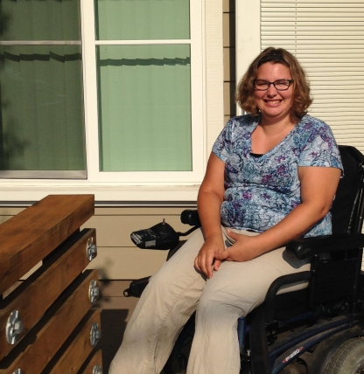

Housing Access Services
Housing for All: Best Practices in IDD Housing Development
February 5, 2025
Darin Lounds, Executive Director
Creating inclusive communities
Notes:
Purple square for image highlight

Slide 2
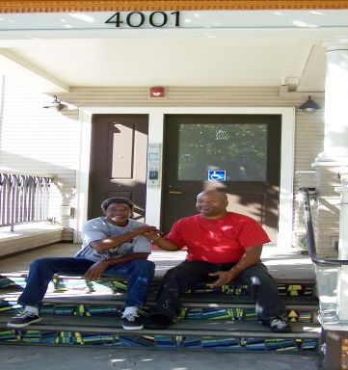
HCEB creates inclusive communities for people with developmental disabilities or other special needs through quality supportive housing
Creating inclusive communities
Notes:
Purple square for image highlight

Slide 3
Housing Access Services
In 2010, HCEB began providing Housing Navigation for unhoused adults with serious mental illness.
  Services include
  Housing readiness (documentation, credit and landlord history)
  Application assistance
  Landlord outreach and relationship-building
  Move-in resources
  Tenancy support
  Coordination with services and supports
Creating inclusive communities
Notes:
Purple square for image highlight

Slide 4

Housing Access Services
In 2010, only a handful of Regional Centers were offering similar services through service code 101.
Service code 101 was not well defined
Services were not eligible for MediCal match
Creating inclusive communities
Notes:
Purple square for image highlight

Slide 5
Housing Access Services
- Everything changes
CMCS Informational Bulletin
DATE: June 26, 2015
FROM: Vikki Wachino, Director
Center for Medicaid and CHIP Services
SUBJECT: Coverage of Housing-Related Activities and Services for Individuals with
Disabilities
Creating inclusive communities
Notes:
Purple square for image highlight

Slide 6
Housing Access Services
- Success for a System
LHA submitted a proposal to ARCA for Housing Access Services
    Individual Housing Transition Services
    Individual Housing and Tenancy Sustaining Services
    Housing Related Collaborative Activities
    Property Management and Environmental Modification Services
    Rental Housing Assistance for Homeless, At-Risk of Homelessness, and Individuals Exiting Institutional Settings
Creating inclusive communities

Slide 7

Housing Access Services
- Success for a System
January 2018: CA Department of Health Care Services Statewide Transition Plan for Compliance with HCBS Settings Rule
  Included
    Individual Housing Transition Services
    Individual Housing and Tenancy Sustaining Services
  These services were codified as Service Code 089.
Creating inclusive communities

Slide 8
Housing Access Services
- Success for a System
  Individual Housing Transition Services
    Provide direct support and assistance with activities and processes associated with an individual’s preparation for, and transition to, housing.
  Individual Housing and Tenancy Sustaining Services
    To support individuals to maintain tenancy once housing is secured. The availability of ongoing housing-related services fosters community integration and inclusion and develops natural support networks.
Creating inclusive communities

Slide 9
Housing Access Services
in the East Bay
In 2018, HCEB entered into an MOU with Contra Costa County Housing Authority to secure Non-Elderly Disabled Mainstream Vouchers for adults receiving RCEB services
After vouchers were awarded, RCEB vendored HCEB for the new Housing Access Services service code (089)
Creating inclusive communities
Notes:
Purple square for image highlight

Slide 10
Housing Access Services
in the East Bay
Key elements of CCCHA and HCEB MOU
Where requested, assist households in their housing search
Assist households to identify funds for unit accessibility modification as a reasonable accommodation for their disabilities
Provide technical assistance to owners for making reasonable accommodations or making units accessible for disabled persons
Provide technical assistance to prospective owners
Provide tenant-landlord liaison services to tenants when needed or requested
Creating inclusive communities
Notes:
Purple square for image highlight

Slide 11
Housing Access Services
in the East Bay
HCEB negotiated a "Usual and Customary" rate with RCEB.
The rate was based on various HCEB Housing Navigation contracts with local jurisdictions to provide HN for homeless adults, some with serious mental illness and other disabilities.
Typical POS authorization: 10 hours/month/person
Creating inclusive communities
Notes:
Purple square for image highlight

Slide 12
Housing Access Services
in the East Bay
In addition to providing HAS for consumers who receive CCC Mainstream Vouchers, HCEB has also received referrals for other RCEB consumers who require assistance securing independent housing.
HCEB HAS Point Person: Crystal Warren, cwarren@hceb.org, 415.531.2019
Creating inclusive communities
Notes:
Purple square for image highlight

Slide 13
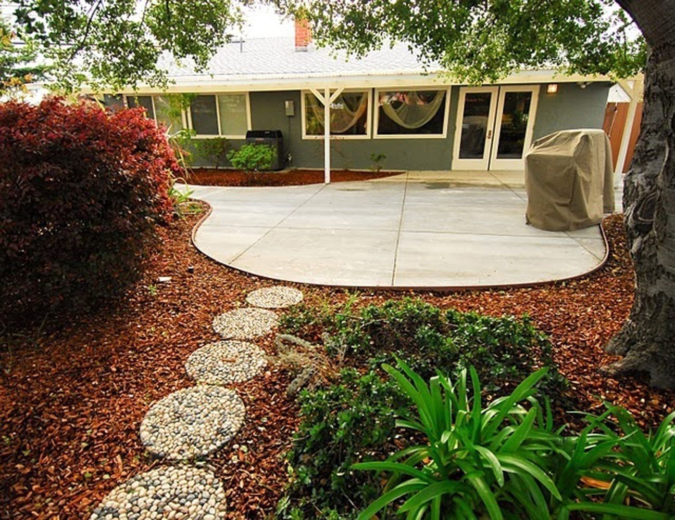
Thank You!
Creating inclusive communities
Notes:
Purple square for image highlight

