Slide 1
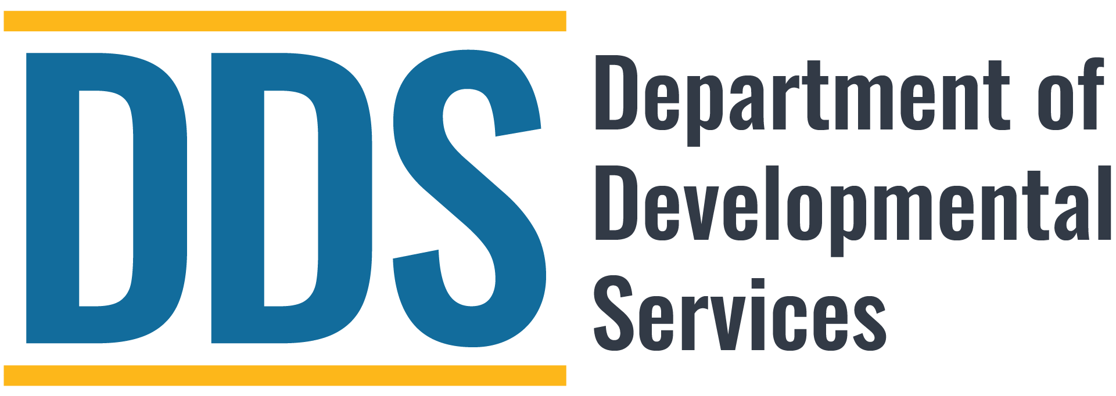
Office of Community Development
Multifamily Housing Presentation
February 5, 2025
-From Proposal to Approval-
What is the Regional Center’s and DDS’ application process and timeline to evaluate and consider a Developer’s loan proposal and recommended loan approval?

Slide 2
Community Resource Development Plan (CRDP)
  Welfare and Institutions Code section 4679 was added to address Community Placement Plan (CPP) funding for the needs of individuals with I/DD who live in the community. DDS identifies this funding as CPP/CRDP.
  Currently, DDS provides an annual allocation of approximately $78M in CPP funds to the Regional Centers. Of the total CPP fund amount, approximately $27M is allocated to the Regional Centers for the development of resources.
  DDS has authorization to allocate the remaining CPP funds to Regional Centers to support development of proposed CRDP resources when DDS has determined that sufficient funding has been appropriated and reserved for CPP.
  Guidelines that include procedures and timelines can be found on the DDS website at https://www.dds.ca.gov/services/cpp/

Slide 3
DDS – CPP/CRDP Multifamily Housing Presentation Objectives
  What kinds of projects are eligible?
  Is there a maximum award?
  Uses of funding: capital, subsidy, other?
  Utilization of the program?
  Timelines for the use of funds?
  Application process?

Slide 4


Allowable Uses of CPP/CRDP
Multifamily Housing Funds
Predevelopment
Acquisition
Renovation
New Construction

Slide 5

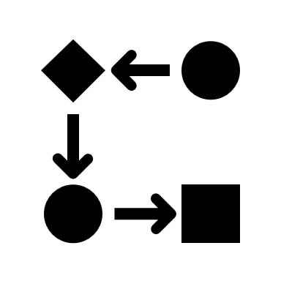

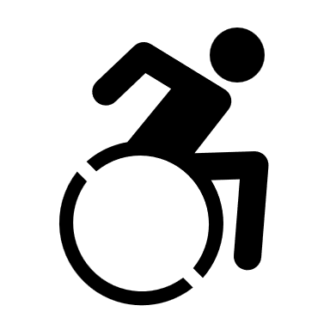
DDS and Regional Center
CRDP Application Submittal
Regional Center submits a project summary/application to DDS that includes, but not limited to:
  Readiness, proposed development timeline.
  Location, proximity to amenities/transportation, DDS unit composition, etc.
  Finance structure and related loan documents.
  Experience, capacity, and roles of development team/partners.

Slide 6
DDS - RC Multifamily Housing Process
Project Timeline/Project Readiness
DDS Project Terms
Developer/Consultant Contracts
Project Summary/Application submitted to DDS by RC.
Regional Center Supportive Services in-kind Budget
Project Team Roles and Responsibilities
Project Team Project Status Calls
Project Financing

Slide 7
Key Elements and Benefits of Including Individuals with ID/DD - “Set-Aside” Model
Regional Center:
DDS:
Use Restriction
Affordability
Accessibility
Leveraging of Housing Resources
Independent/Supportive Living
Elevate individuals/families with greatest needs
Integrated Supportive Services
Community Integration

Slide 8

DDS/Regional Center Multifamily Production
FY 2007/08 to FY 2024/25
    Total CPP/CRDP Funds – $64,171,900
    Total Projects Completed and In-Progress – 51
    Total Housing Units – 3,994
    Total DDS/Regional Center Set Aside Units – 697
.

Slide 9
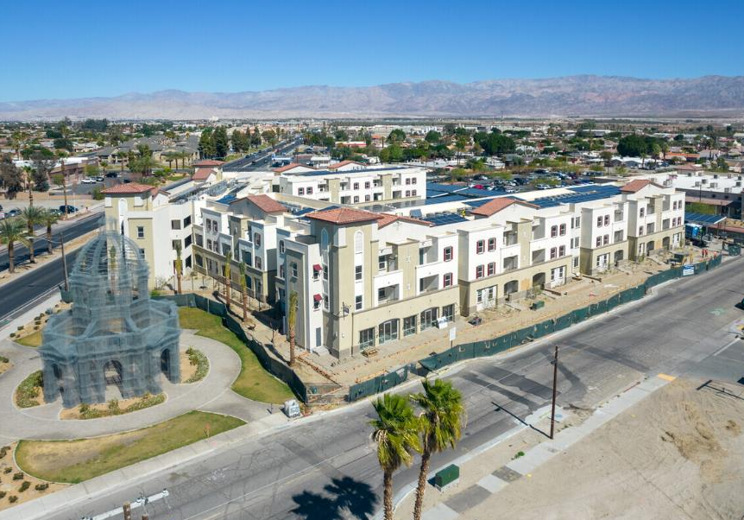
DDS/Regional Center Multifamily Production FY 2007/08 to 2024/25 – Permanent Loans
      14 permanent loan conversions
      Total units – 978
      Total DDS/Regional Center set aside units – 180 units
      Total development costs – $573,754,241 (approximately $586,661 per unit)
      Total CRDP funding – $15,862,770 (approximately $88,127 per unit)
.

Slide 10
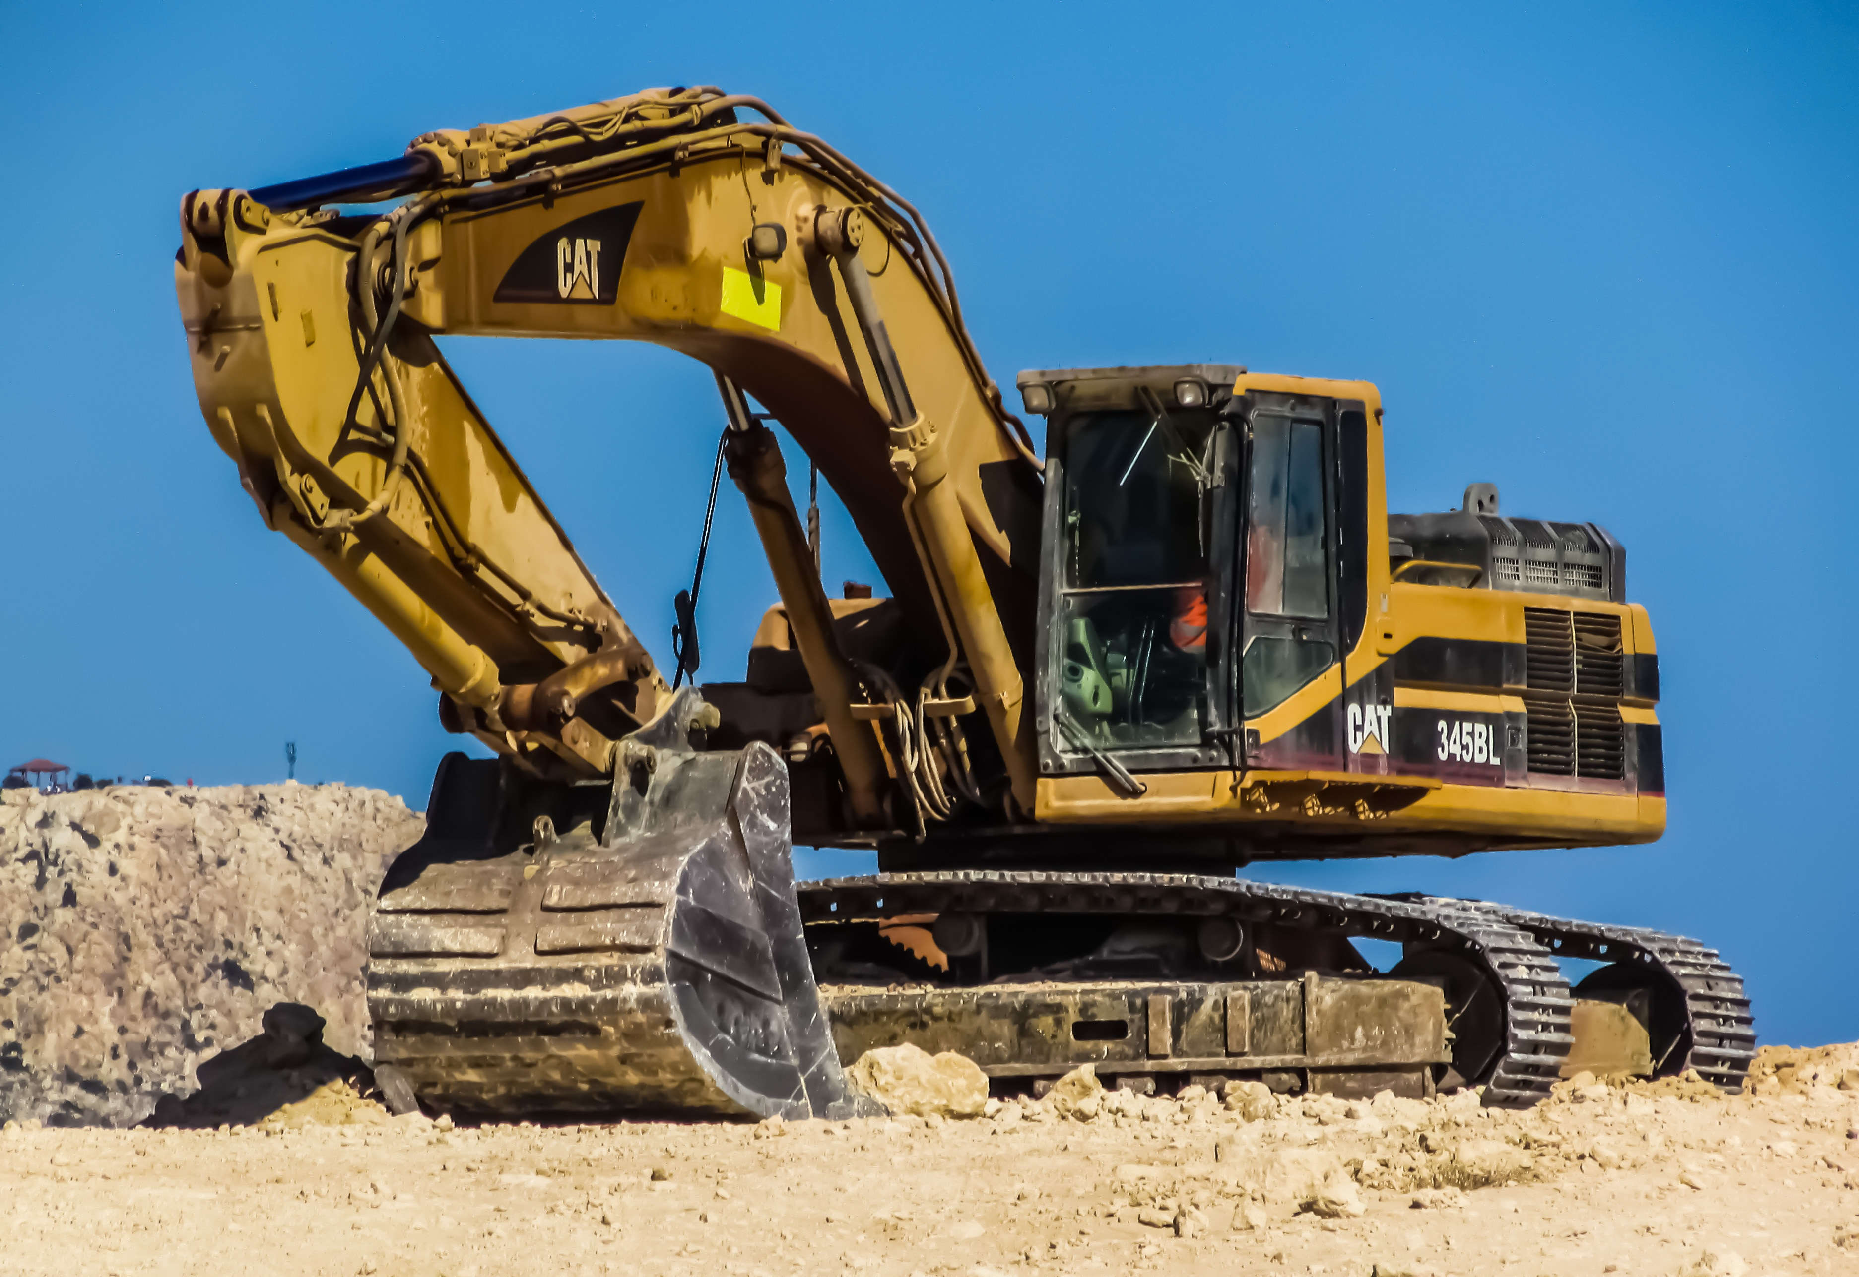
DDS/Regional Center Multifamily Production FY 2007/08 to 2024/25 – Construction Loans
      37 construction loans (13 closed, in various stages, 24 in pre-application process)
      Total units – 3,016
      Total DDS/Regional Center set aside units – 514
      Total CRDP funding – $48,309,130 (approximately $93,987 per unit)
.

Slide 11
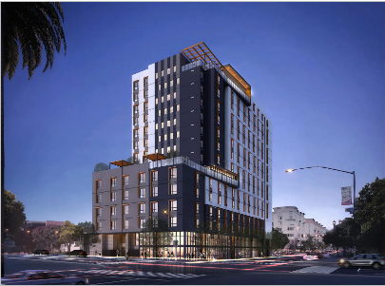
Harrington Heights
1320 Broadway, San Diego, CA 92021
Developer: Chelsea Investment Corporation
Total Units: 273
Total SDRC set units: 40
Total Development Costs: $150,140,991 ($549,967 per unit)
Total CRDP Funding: $4,250,000 ($106,250 per unit)
DDS Factoid: Largest DDS project (amount of funding and set aside units).
.

Slide 12
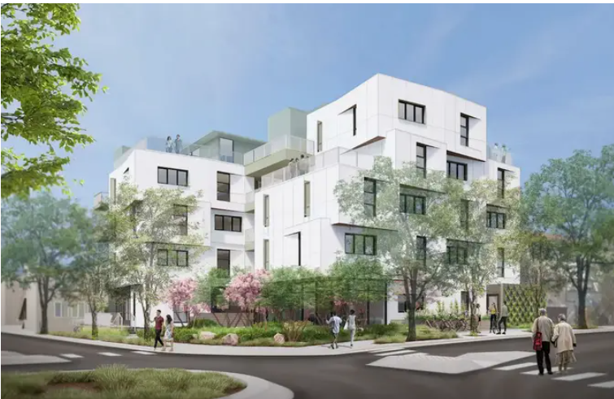
Lexington Gardens
1201-1207 North Detroit St. West Hollywood, CA 90046
Developer: EAH Housing Inc.
Total Units: 48
Total FDLRC set aside units: 12
Total Development Costs: $41,053,695 ($855,285 per unit)
Total CRDP Funding: $1,500,000 ($125,000 per unit)
DDS Factoid: All 12 FDLRC units received Section 8 rental subsidies.
.

Slide 13
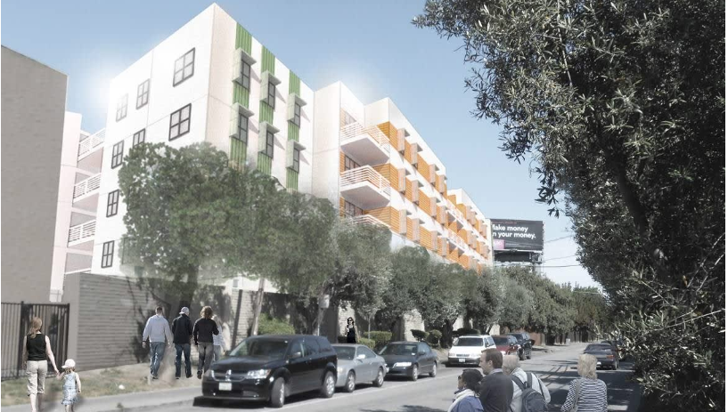
Light Tree Two Apartments
1805 East Bayshore Avenue, East Palo Alto, CA 94303
Developer: Eden Housing
Total Units: 128
Total GGRC set aside units: 10
Total Development Costs: $111,483,066 ($870,961 per unit)
Total CRDP Funding: $1,000,000 ($100,000 per unit)
DDS Factoid: All 10 GGRC units received Section 8 rental subsidies.
.

Slide 14
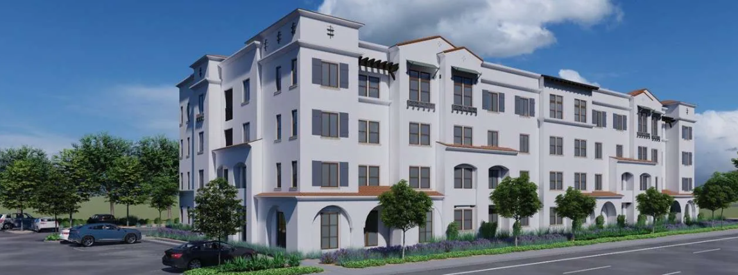
South River Village
4933 North River Road, Oceanside, CA 92057
Developer: Mirka Investments
Total Units: 43
Total SDRC set aside units: 15
Total Development Costs: $25,257,852 ($587,391 per unit)
Total CRDP Funding: $510,000 ($34,000 per unit)
DDS Factoid: Lowest CRDP dollar amount per unit in DDS history.
.

Slide 15
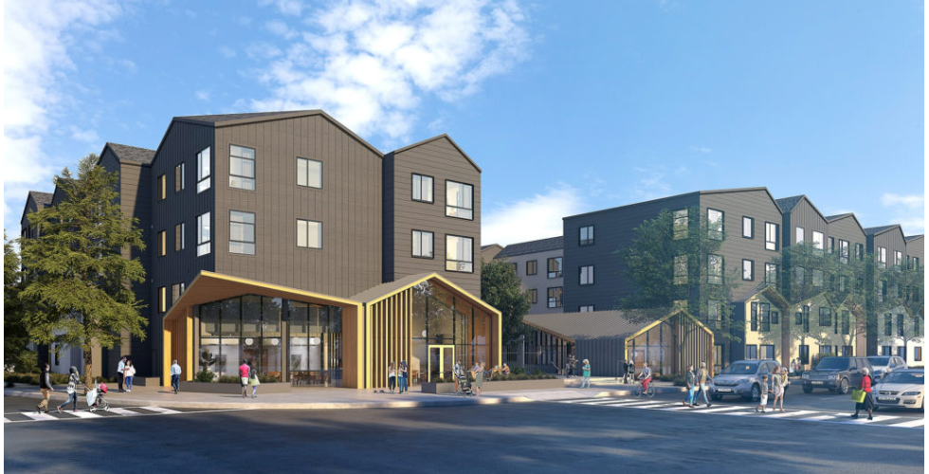
The Meridian fka Sunnyvale Block 15
397 South Matilda Avenue, Sunnyvale, CA 94086
Developer: Related California
Total Units: 90 Total
Total SARC set aside units: 23
Total Development Costs: $84,162,469 ($935,138 per unit)
Total CRDP Funding: $1,000,000 ($43,478 per unit)
DDS Factoid: 2nd lowest CRDP funding amount per unit in DDS history.
.

Slide 16
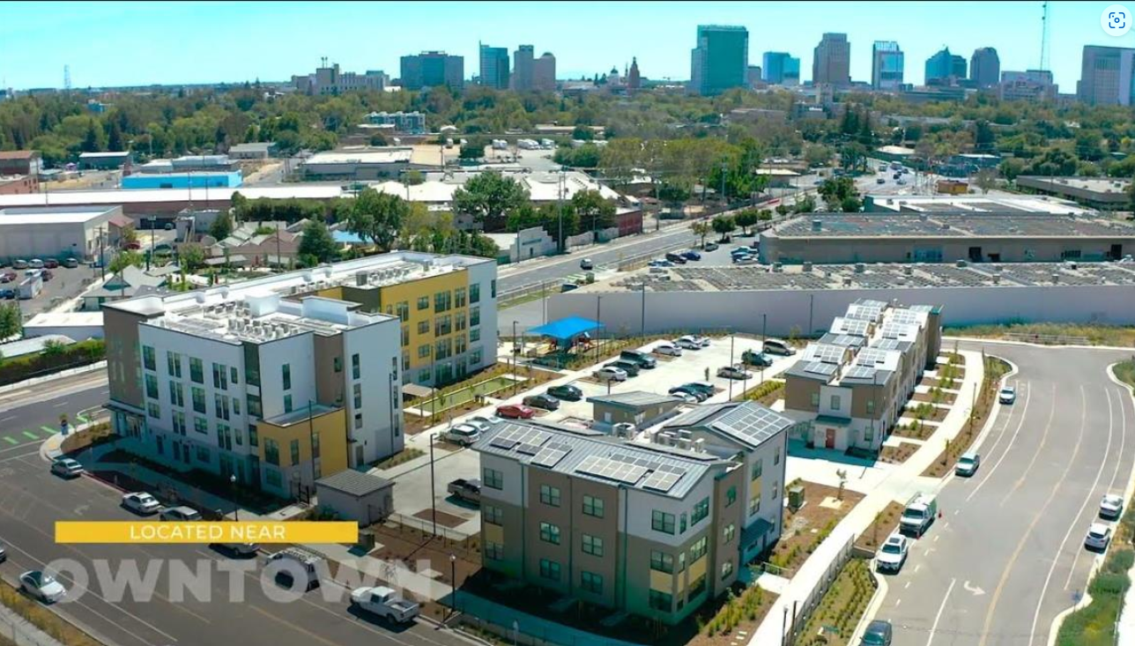
Marisol Village fka Twin Rivers Block A
1200 Richards Blvd, Sacramento, CA 95811
Developer: McCormack Baron Salazar
Total Units: 104
Total ACRC set aside units: 15
Total Development Costs: $61,123,069 ($587,721 per unit)
Total CRDP Funding: $1,500,000 ($100,000 per unit)
DDS Factoid: First phase of a six phase, affordable housing development.
.

Slide 17
Piper Way Senior Apartments
3294 Piper Way, Redding, CA 96001
Developer: Christian Church Homes
Total Units: 60
Total FNRC set aside units: 9
Total Development Costs: $36,383,523 ($606,392 per unit)
Total CRDP Funding: $739,130 ($82,125 per unit)
DDS Factoid: First EVER Senior I/DD affordable housing, all 9 units
receive Section 8 rental subsidies.
.

Slide 18
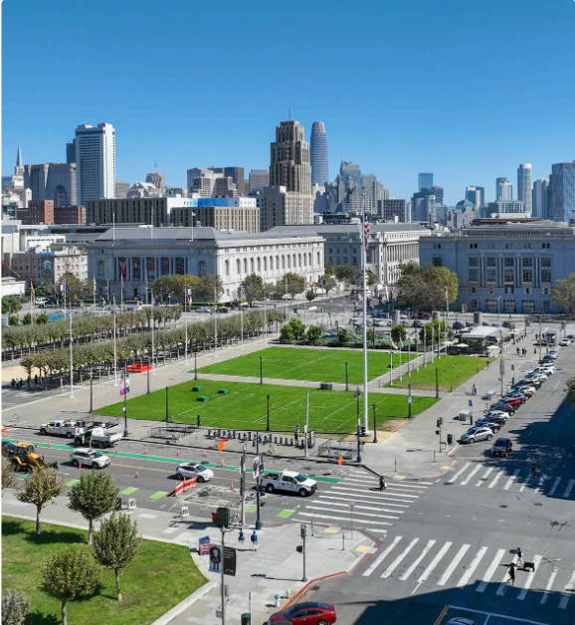
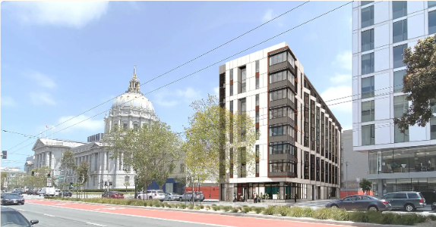
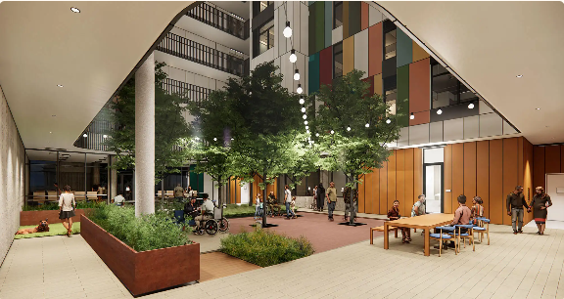
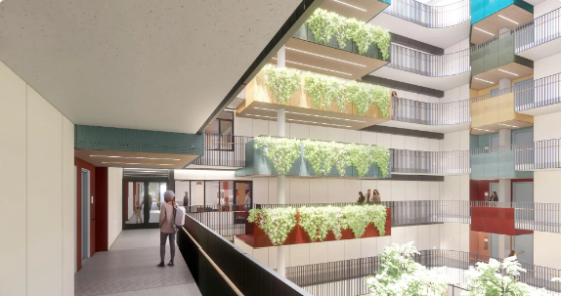
Kelsey Civic Center
240 Van Ness Avenue, San Francisco, CA 94102
Developer: Mercy Housing Corporation / Kelsey Group
Total Units: 112
Total FNRC set aside units: 14
Total Development Costs: $88,324,966 ($788,616 per unit)
Total CRDP Funding: $1,000,000 ($71,429 per unit)
DDS Factoid: Unique design with only studio and 2-bedroom units.
.

