Slide 1

HOUSING

Slide 2
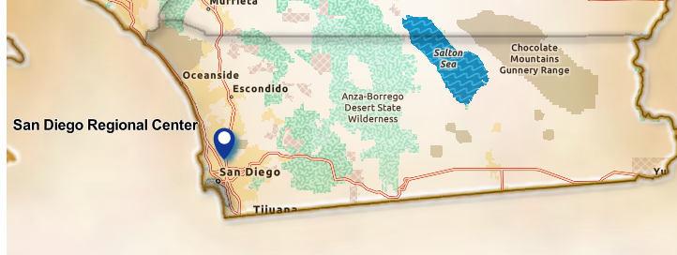
MISSION
    Serving San Diego and Imperial Counties
    SDRC’s Mission: To serve and empower persons with developmental disabilities and their families to achieve their goals with community partners.
    The mission of the Community Services Department: To provide high quality and meaningful services that are reflective of the diversity of the community of people served by San Diego Regional Center in collaboration with families, agency staff, and community partners. The Community Services Department develops community partnerships through outreach and education about issues and services affecting individuals with developmental disabilities.

Slide 3

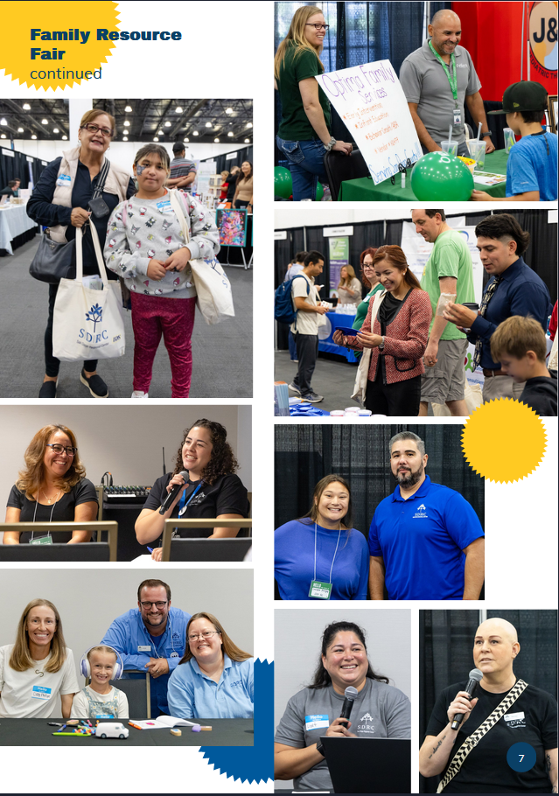
Why focus on Housing?
    Community input:
    •There is a shortage of affordable housing in communities where people want to live.
    •Housing that is available, is not always accessible.
    •The need to support clients and families to plan for long-term future housing needs.

Slide 4
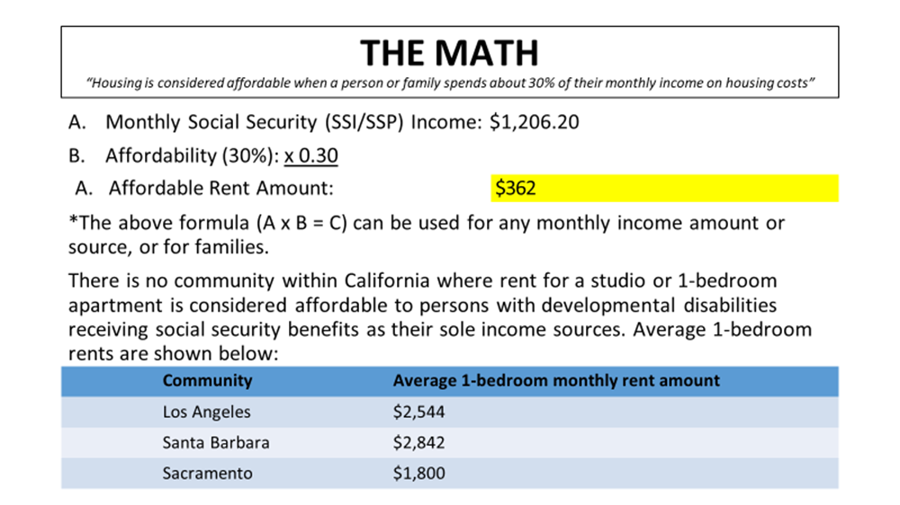

Slide 5
OVERCOMING THE MATH
“In order to overcome the math, you need to know your rent gap”
Finding your rent gap: Your rent gap is the difference between rent in your
community and 30% of your monthly income.
Monthly and annual rent gap example:
Rental assistance or subsidies can cover and help pay for your rent gap.
 | Item | Los Angeles | Santa Barbara | Sacramento
A | Average Monthly Rent | $2,544 | $2,842 | $2,842
B | Less: Affordable (30%) | ($362) | ($362) | ($362)
C | Your Monthly Rent Gap | $2,182/month | $2,480/month | $1,438/month
D | Your Annual Rent Gap (Monthly Gap x 12) | $26,184/year | $29,760/year | $17,256/year

Slide 6
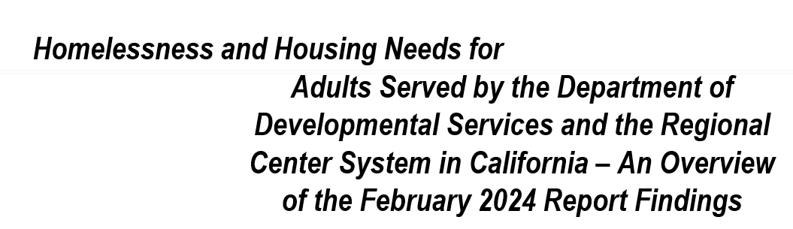
Approximately 24,000 adults (22 years +), served by the Regional Center system in Independent or Supported Living, are rent burdened (paying 30% or more of their income for housing) or severely rent burdened (paying 50% or more of their income for housing)

Slide 7
SDRC Strategic Goals and Housing
Life Planning Series (workshop)
Housing supports and affordable housing projects
Coordinated Family Supports
Southern CA Housing Collaborative (SCHC)

Slide 8

Life Planning Series
A virtual workshop series to help families develop a life plan for a family member with a disability.

Slide 9

◦ In 2007, the Foundation for Developmental Disabilities surveyed the adult individuals served by the San Diego Regional Center to gather information on what they struggled with the most. The answers were very consistently affordable housing, employment, and transportation.
◦ In 2008, the Southern CA Housing Collaborative (SCHC) was incorporated.
◦ SCHC ‘s specific purpose is to address the housing needs of persons with developmental disabilities by identifying, enhancing, preserving, developing, funding, and administering decent housing that is affordable to individuals with developmental disabilities with low incomes.

Slide 10
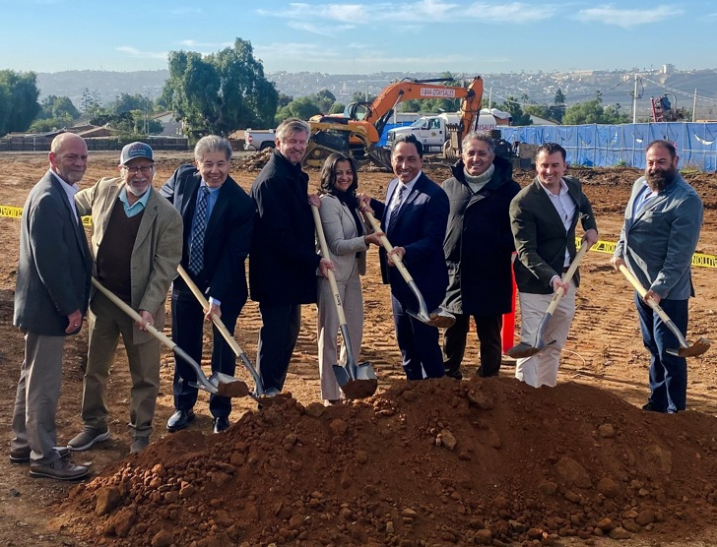

SCHC
SCHC created partnerships with appropriate agencies in order to apply for federal, state, and municipal funds to create rental developments with a percentage of affordable units set aside for persons with developmental disabilities residing in San Diego and Imperial Counties.

Slide 11
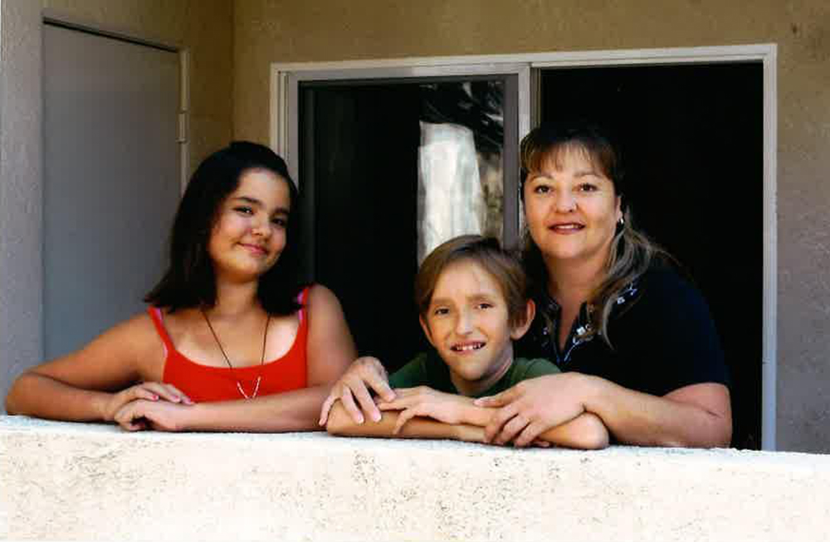
Southern CA Housing Collaborative (SCHC) Projects
    Affordable Housing Projects with SDRC :
        Independence Point- 25 units for SDRC
        Villa Primavera – 17 units for SDRC (Imperial County)
        Ouchi Courtyards- 7 units for SDRC
        Pacifica at Playa del Sol – 12 units for SDRC
        Serenita- 15 Units for SDRC (Imperial County)
        Girasol (Countryside II)- 10 units for SDRC (Imperial County)

Slide 12
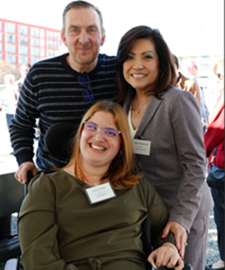
Harrington Heights
Harrington Heights will be a 15-story building that will include 270-unit affordable rental apartments; all the units will be affordable
SDHC awarded 115 rental housing vouchers to help Harrington Heights residents pay their rent. Of those, 75 will assist people experiencing homelessness, including 10 set aside specifically for veterans experiencing homelessness.
According to the housing commission, the remaining 40 vouchers will be for households with lower income who are not experiencing homelessness, with annual income ranging from 25 to 40% of AMI. All the vouchers SDHC awarded are tied to the development, so when a resident moves on, the housing voucher remains to help the household that moves into a new unit at the property.

Slide 13
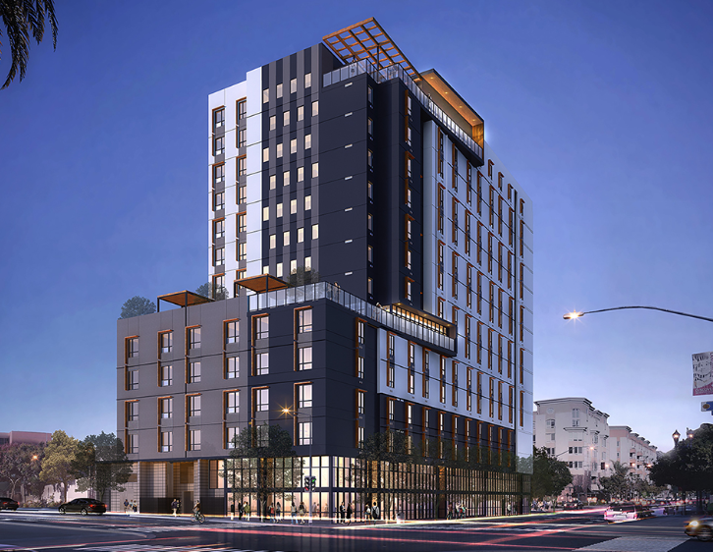
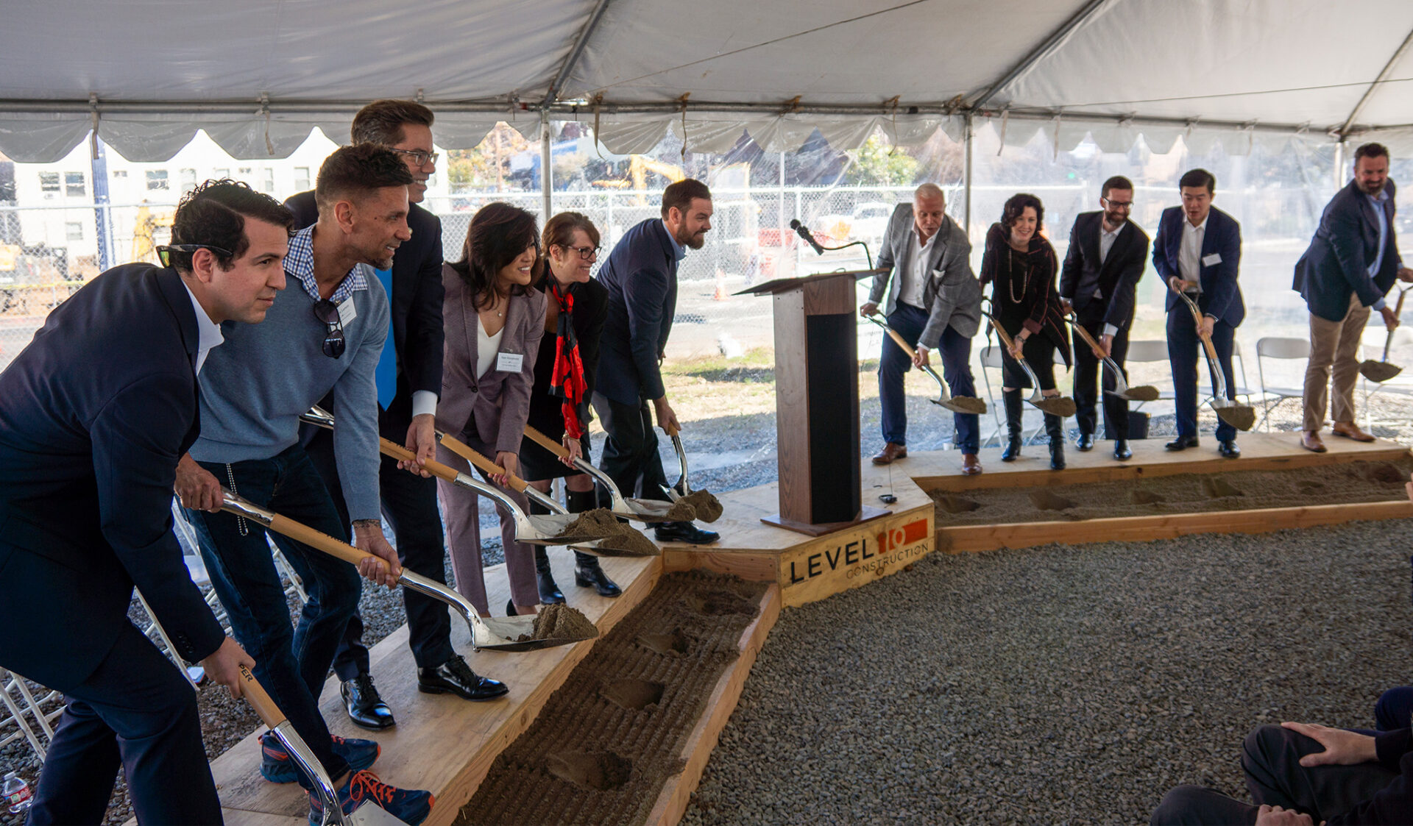
Harrington Heights
40 Units for SDRC

Slide 14
Southern CA Housing Collaborative (SCHC) Projects
          Mt. Etna- MODICA- 30 units for SDRC
          Mt. Etna-Taormina – 26 units for SDRC
          Miraluz – 10 units for SDRC
          Trails- 15 units for SDRC
          SCHC is also working with Chelsea on their San Diego State deal in Mission Valley near Snapdragon Stadium in Mission Valley. It is a very desirable location because of the proximity to transportation and other important amenities. Units for SDRC are to be determined.
          SCHC is also working with Chelsea on what will be the largest ever affordable housing project in CA known as “Midway Rising”. The project will be built in stages, eventually delivering 2,000 affordable units to San Diego. This project will be located where the Sports Arena now sits. Units for SDRC are to be determined.

Slide 15
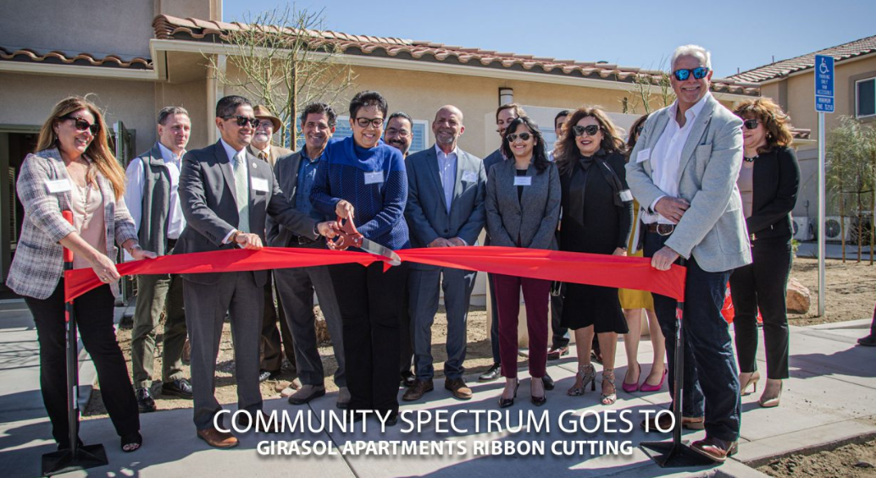
Imperial Valley
Villa Primavera – 17 units for SDRC (Imperial County)
Serenita – 15 units for SDRC (Imperial County)
Girasol (Countryside II) – 10 units for SDRC (Imperial County)

Slide 16
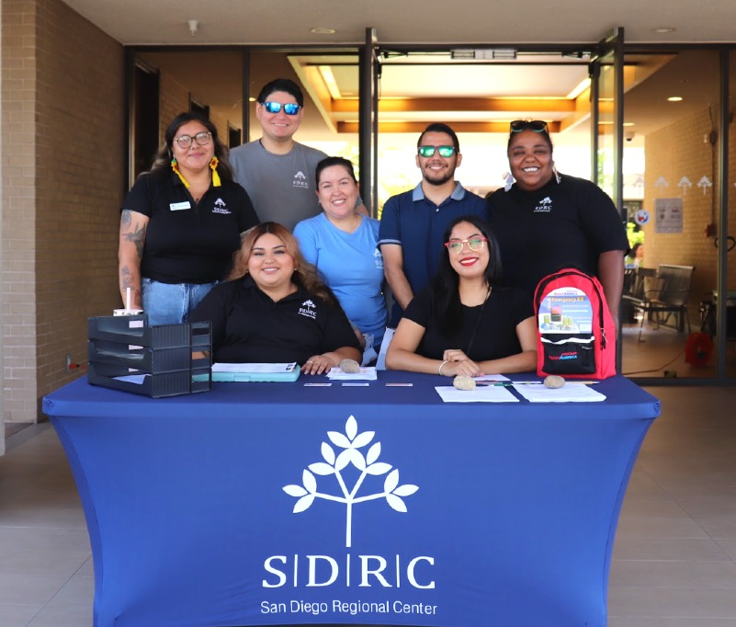
Development Plan and tips
  SDRC has identified priorities for the development of resources under the Community Resource Development Plan (CRDP)
  Helpful tips:
  Housing Navigator
  Tracking referrals to affordable housing projects
  City Council meetings
  Data, Data, Data
  Outreach and more outreach

Slide 17
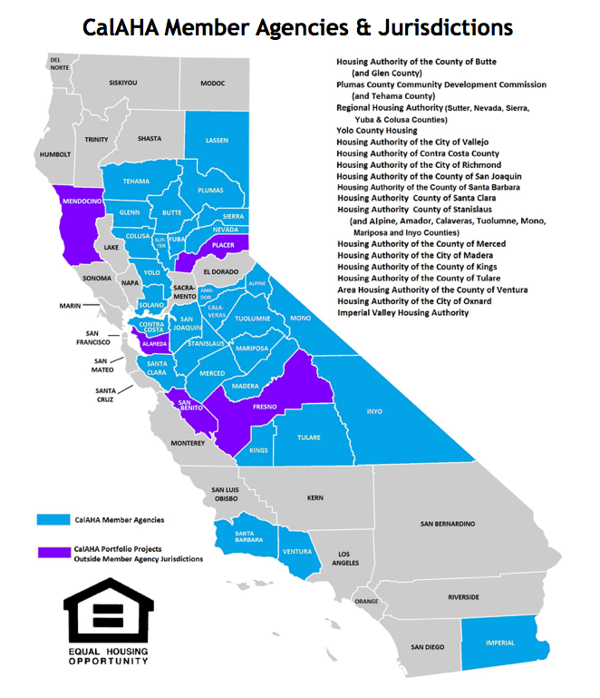
Cal AHA
The California Affordable Housing Agency (CalAHA) was created in 2000 as a Joint Powers Agency (JPA)
The reason for creating CalAHA is a simple one: there is strength in numbers. What a small agency may not be able to achieve on its own, it may be able to accomplish through the resources of multiple members.

Slide 18
THANK YOU
Miguel Larios, M.Ed.
Director of Community Services
San Diego Regional Center
Miguel.Larios@sdrc.org

